Slide 1


Time to Think about Expanding Our Online Retail Accounts

Slide 2

Brief View
Online Retail accounts are our unit sales main driver.
There are some poor performing accounts which may have already deteriorate our unit sales.
It is recommended that we should close the Top 5 worst performing accounts and invest the released resources in more profitable areas, such as expanding our online retail accounts.

Slide 3
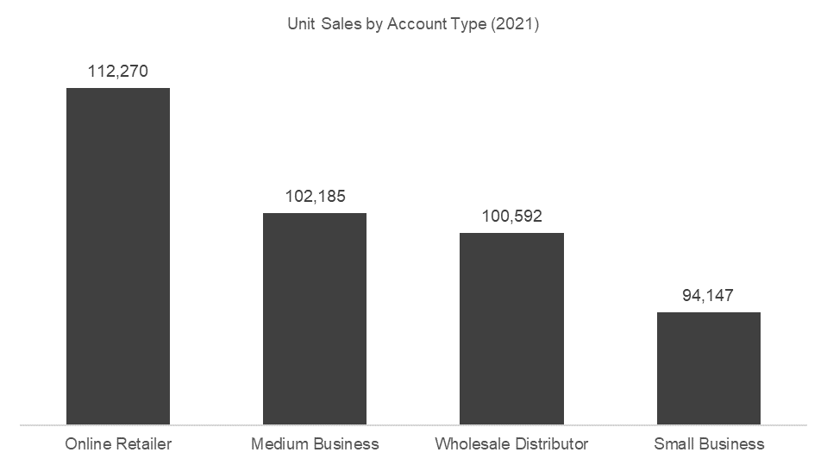
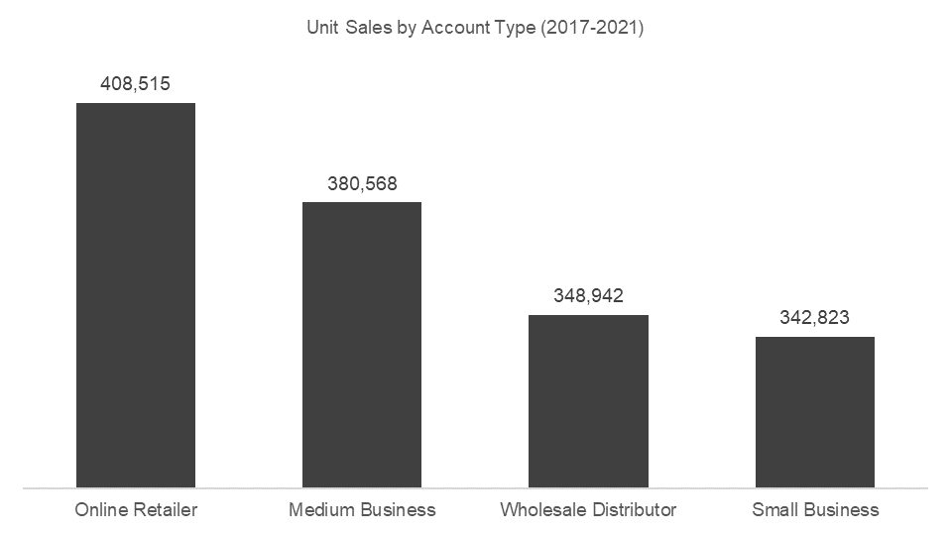
Insights
In 2021, Online Retailer accounts are the main drivers for our unit sales…
…and our overall top unit sales champion in 2017-2021.

Slide 4
Insights
However, we noticed some of our sales accounts are performing poorly.

Slide 5
Key Takeaways
Online Retail accounts are our unit sales main driver.
There are some poor performing accounts which may have already deteriorate our unit sales.
It is recommended that we should close the Top 5 worst performing accounts and invest the released resources in more profitable areas, such as expanding our online retail accounts.

